Slide 1
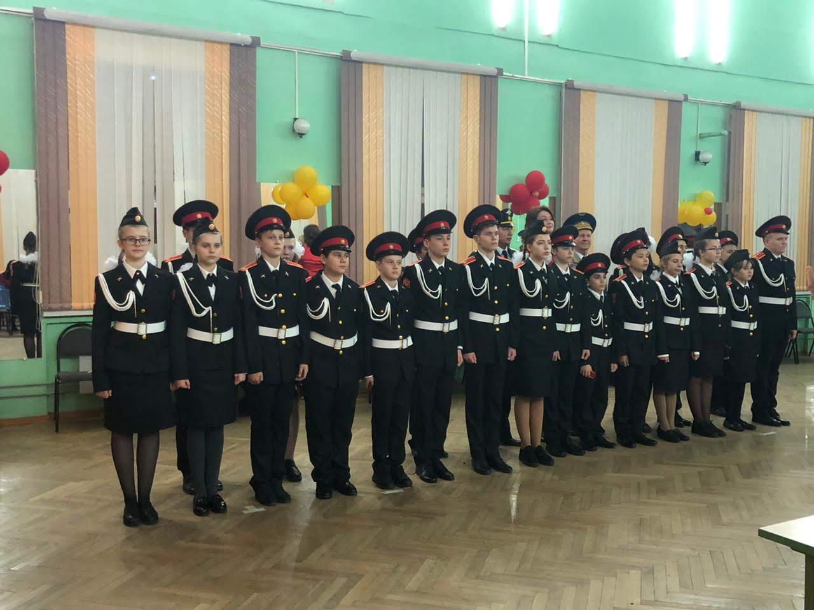
Presentation about the
cadet class
Performed
by Abramova
Alexandra

Slide 2
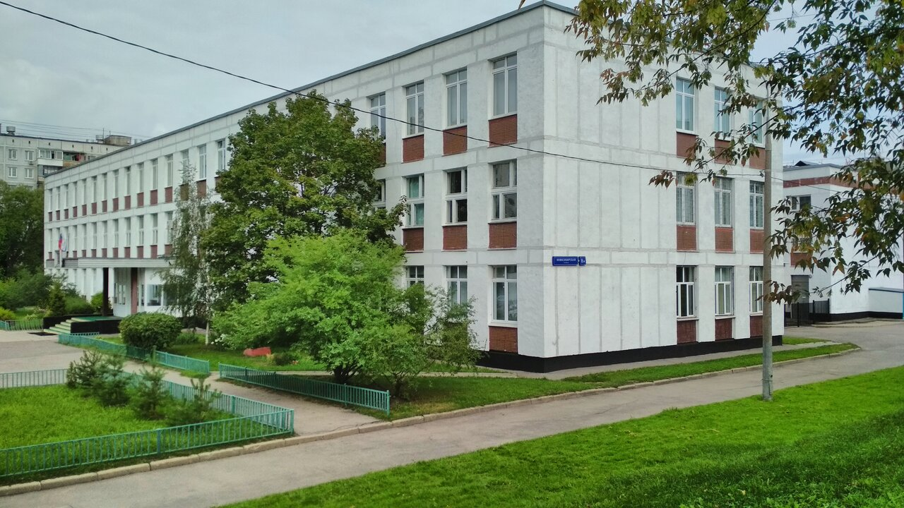
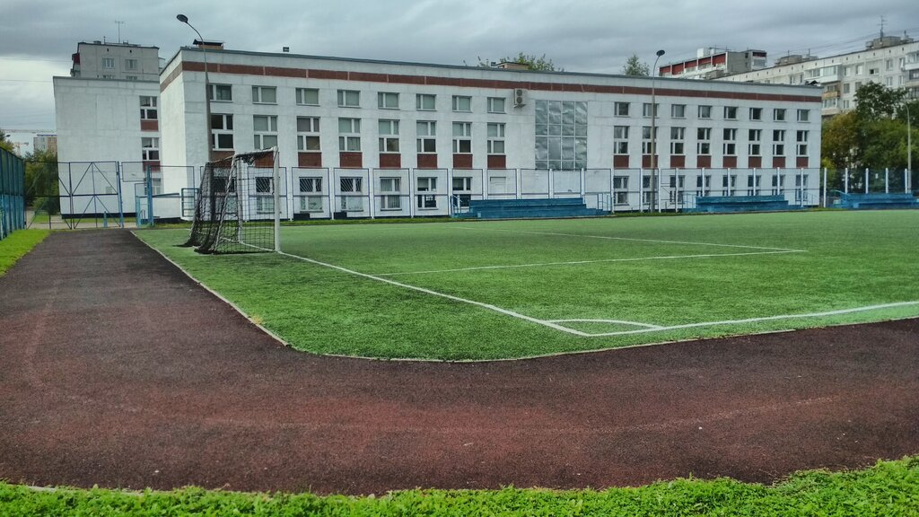
Reasons why I don’t like
the cadet class :
1) We were forced to go to this class;
2) I hate school;
3) Unnecessary lesson and extra classes

Slide 3
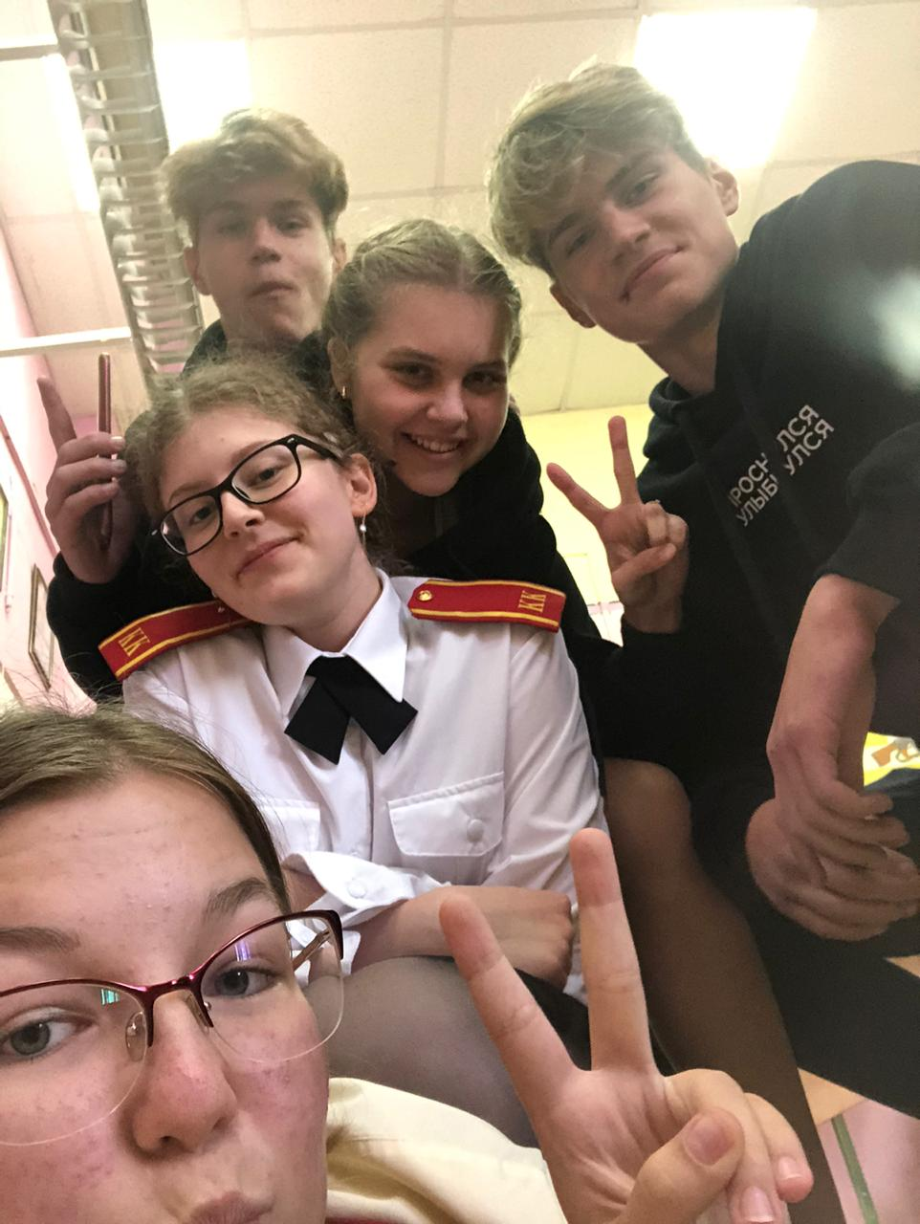
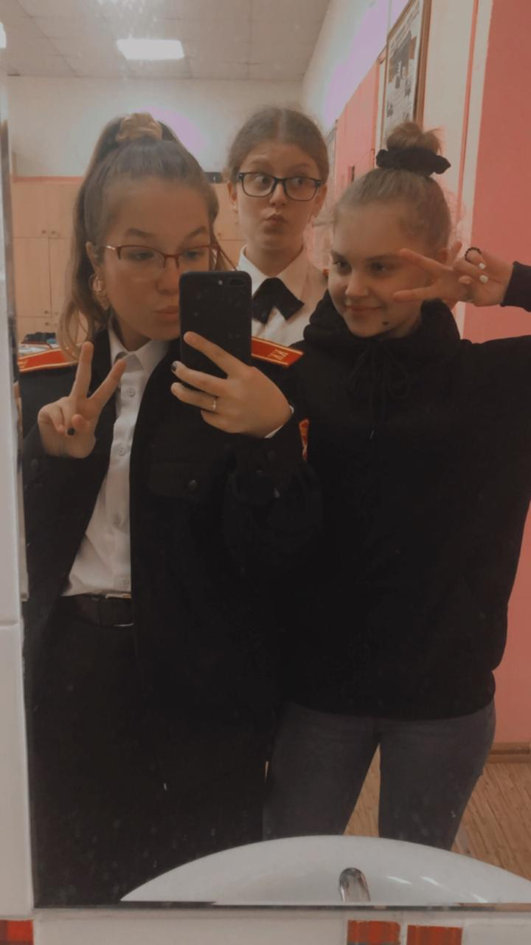
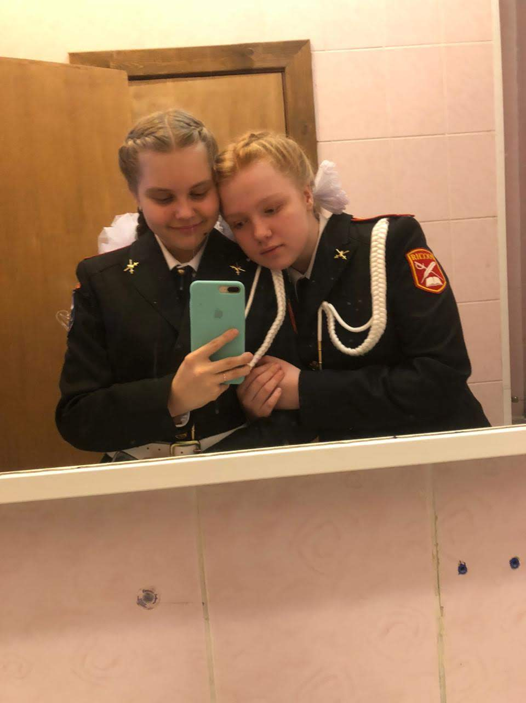
The clothes have many
layers and
it is not
comfortable!

Slide 4
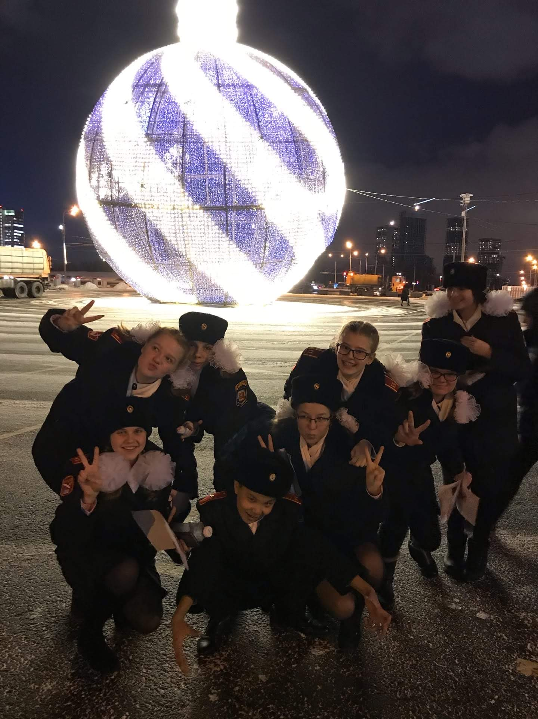
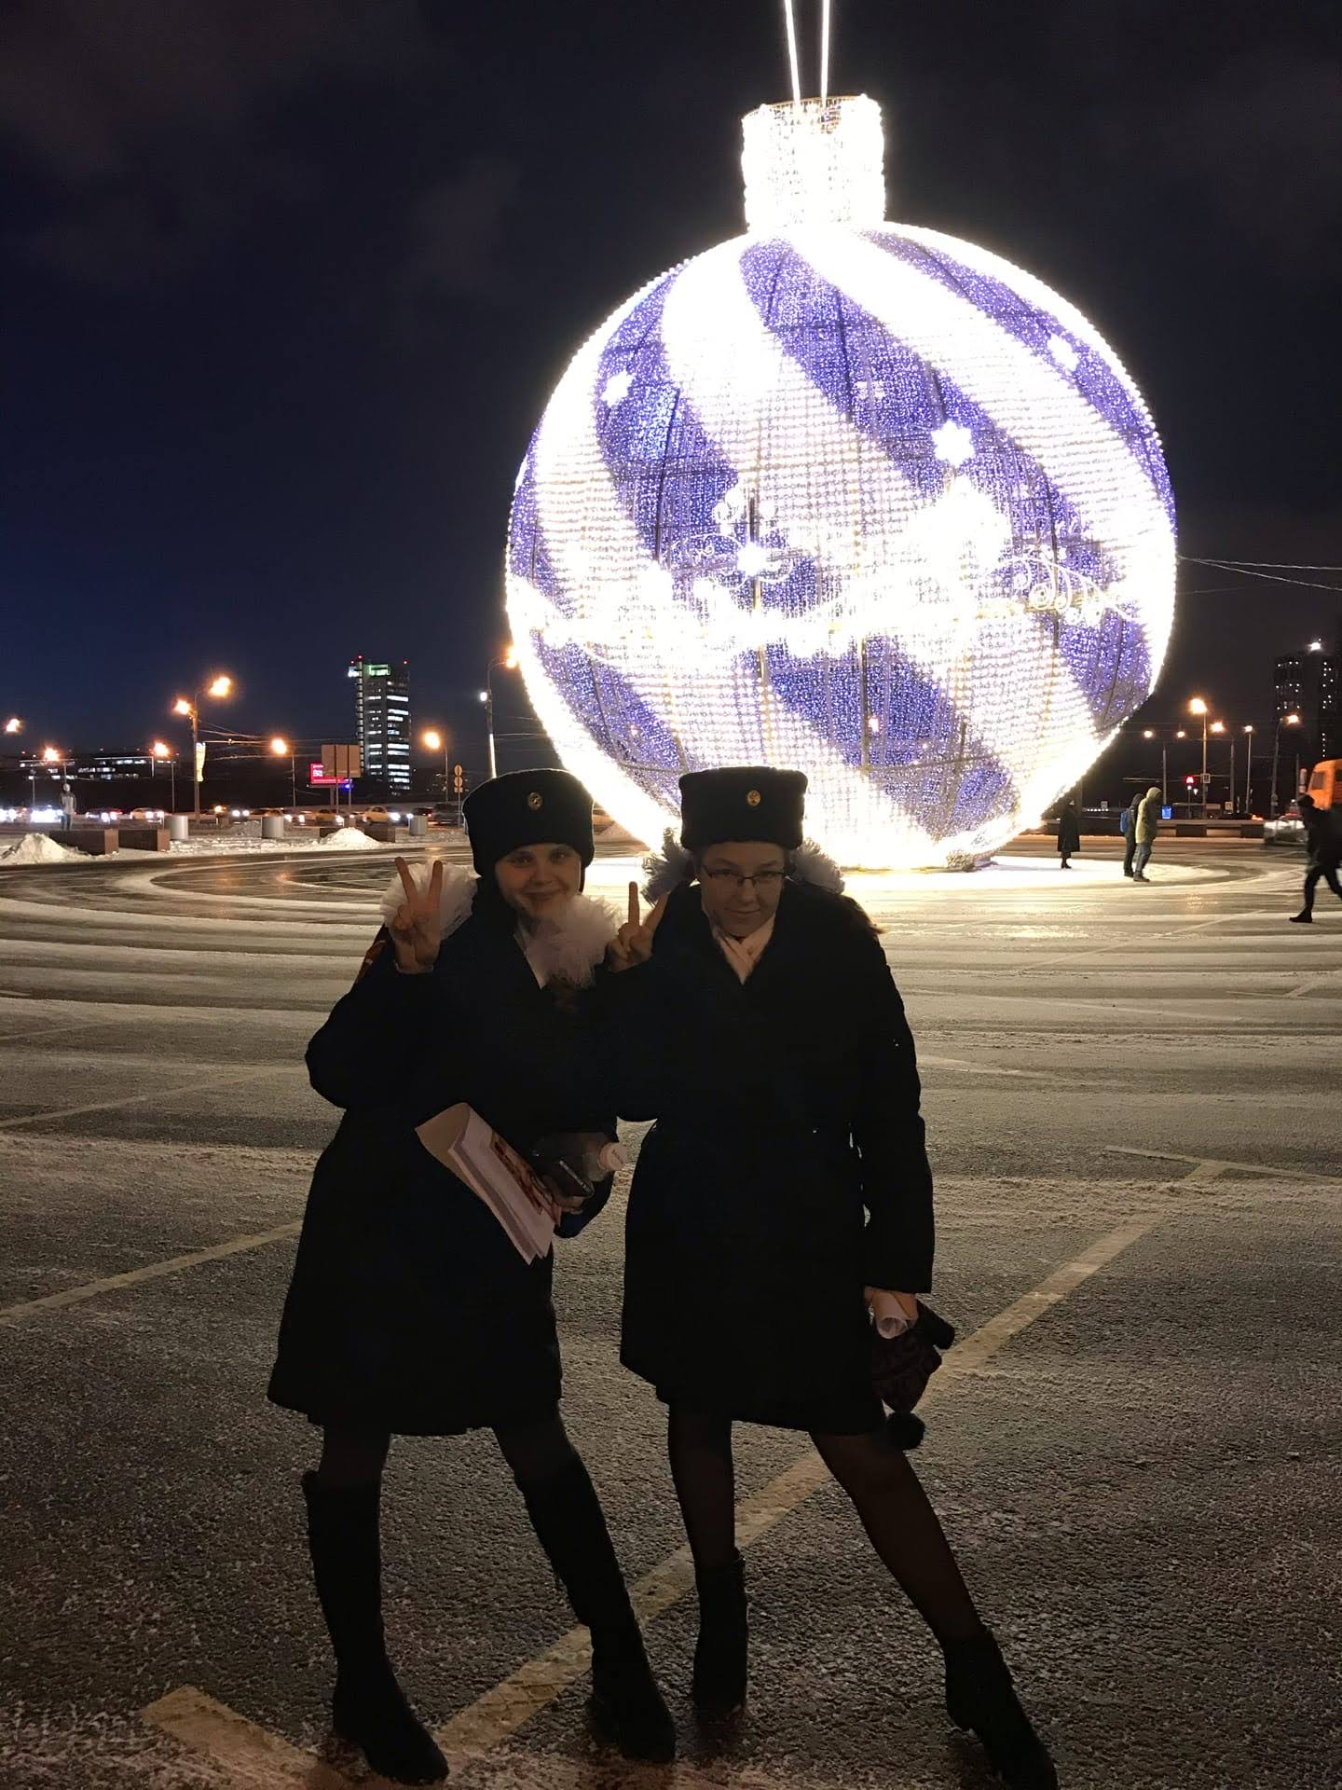
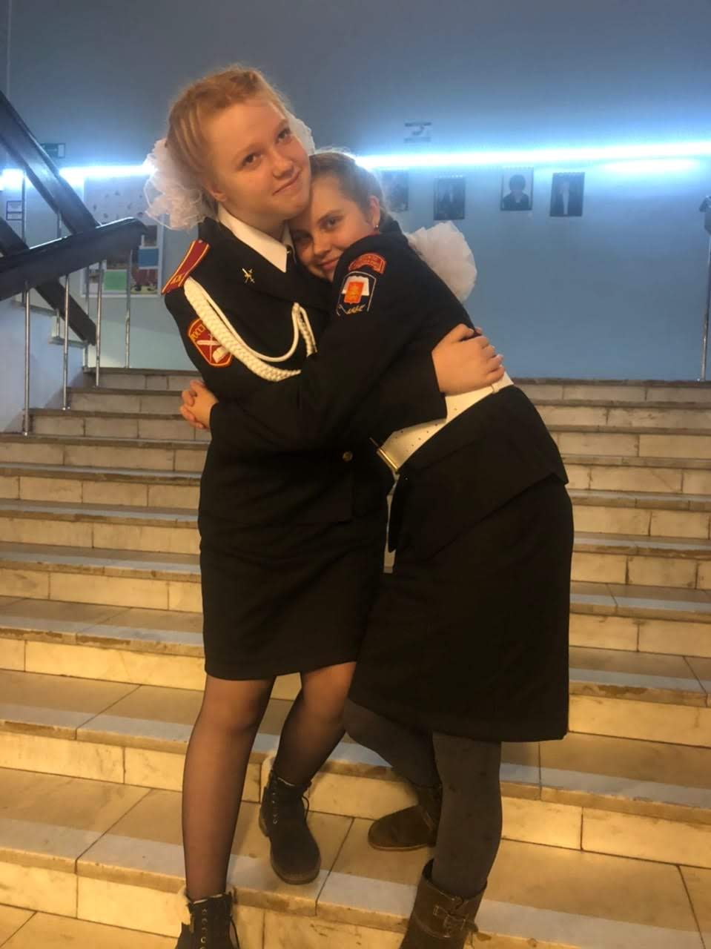
Parades by parades, but
nobody
canceled
the
homework

Slide 5
THE END
Thank you
for watching!

